Slide 1


Slide 2
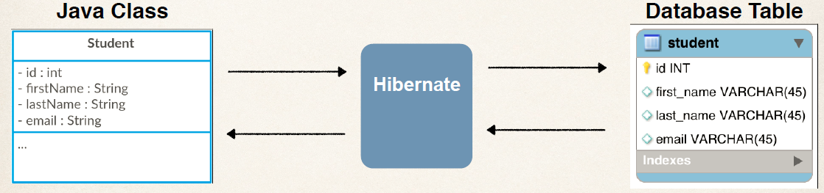
Hibernate Mapping

Slide 3
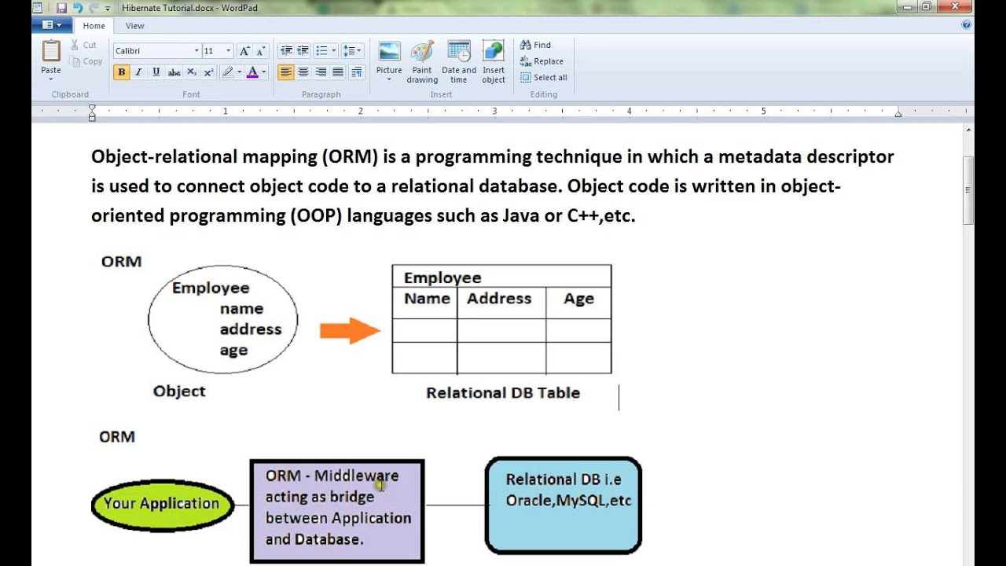
Hibernate Mapping

Slide 4
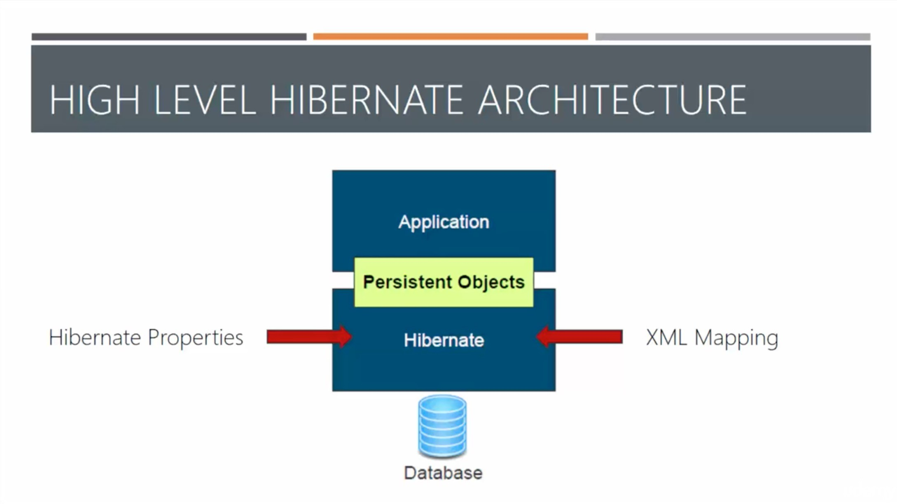
Hibernate HighLevel Architecture

Slide 5
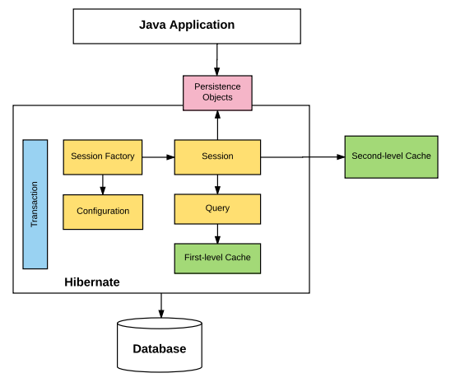
Hibernate Low Level Architecture

Slide 6
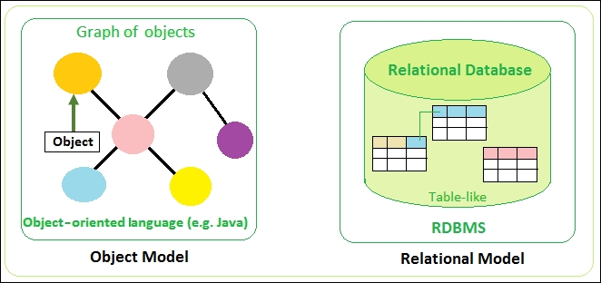
Java Objects – DB Objects

Slide 7


